Slide 1
how computers do calculations
Mikołaj Krupiński

Slide 2
Dictionary
CPU – (procesor) central processing unit, the part of a computer that controls all the other parts
ALU – (jednostka arytmetyczno-logicza) arithmetic logic unit, a combinational digital circuit that performs arithmetic and bitwise operations on integer binary numbers
Logic gate – (bramka logiczna) an electronic switch used in computers that reacts in one of two ways to information given to it (returns either 0 or 1)
Carry – (przeniesienie) while adding in columns: the number that needs to be moved to the next column, because the sum is bigger than 9 (in decimal numeral system)
Integer overflow – (przepełnienie) occurs when an arithmetic operation attempts to create a numeric value that is outside of the range that can be represented with a given number of digits

Slide 3
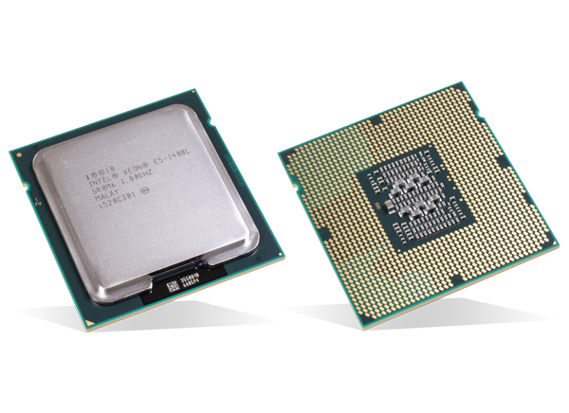
CPU – the heart of every computer
Control Unit
Arithetic Logic Unit
Memory Managment Unit
Others

Slide 4
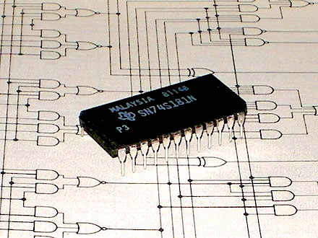
ALU – the heart of every CPU
Arithmetic operatations
Logic operations
Intel 74181 – the first complete ALU on a single chip

Slide 5
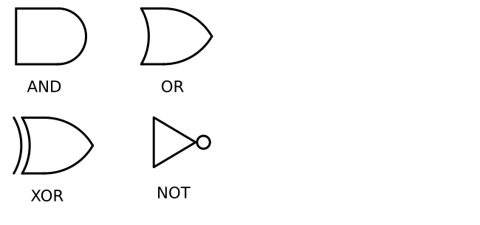
Logic Operations and Gates
A | B | AND | OR | XOR | NOT (A)
0 | 0 | 0 | 0 | 0 | 1
0 | 1 | 0 | 1 | 1 | 1
1 | 0 | 0 | 1 | 1 | 0
1 | 1 | 1 | 1 | 0 | 0

Slide 6
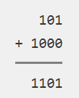
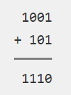
How to add numbers?
9
5
14
Binary number system
  5 [= 0101]
  8 [= 1000]
  5 + 8 = 13 [= 1101]
Bit by bit
A | B | CARRY | SUM
0 | 0 | 0 | 0
0 | 1 | 0 | 1
1 | 0 | 0 | 1
1 | 1 | 1 | 0

Slide 7
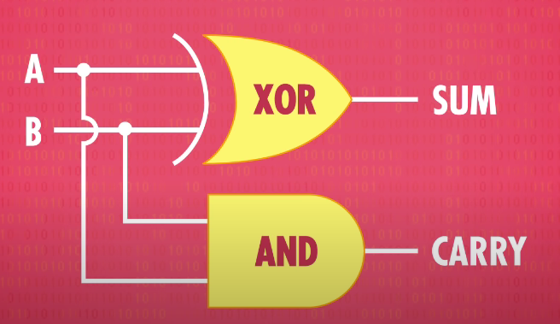
Half adder

Slide 8
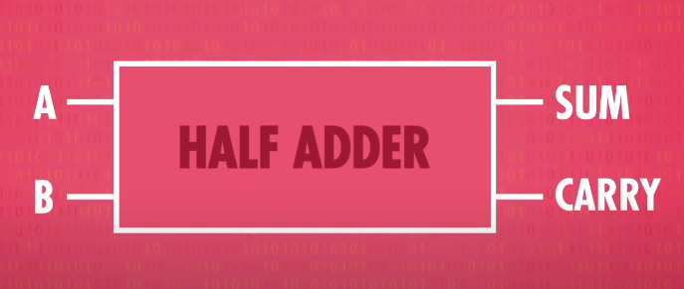
Half adder

Slide 9
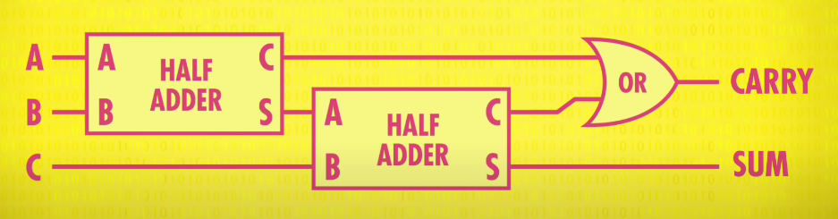
Full adder

Slide 10
Full adder
A | B | C | CARRY | SUM
0 | 0 | 0 | 0 | 0
0 | 0 | 1 | 0 | 1
0 | 1 | 0 | 0 | 1
1 | 0 | 0 | 0 | 1
0 | 1 | 1 | 1 | 0
1 | 0 | 1 | 1 | 0
1 | 1 | 0 | 1 | 0
1 | 1 | 1 | 1 | 1

Slide 11
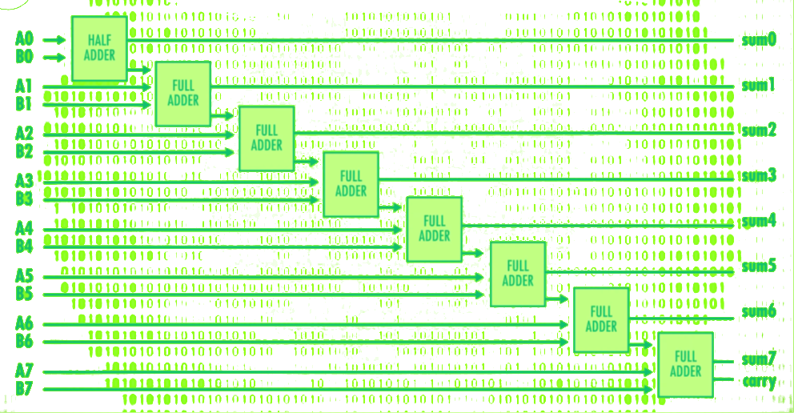
8-bit adder

Slide 12

8-bit adder
Adds numbers from 0 to 255 [$=2^{8}−1$]
What about 160 + 120?
160 + 120 = 280 > 255
OVERFLOW – the last carry is equal 1

Slide 13
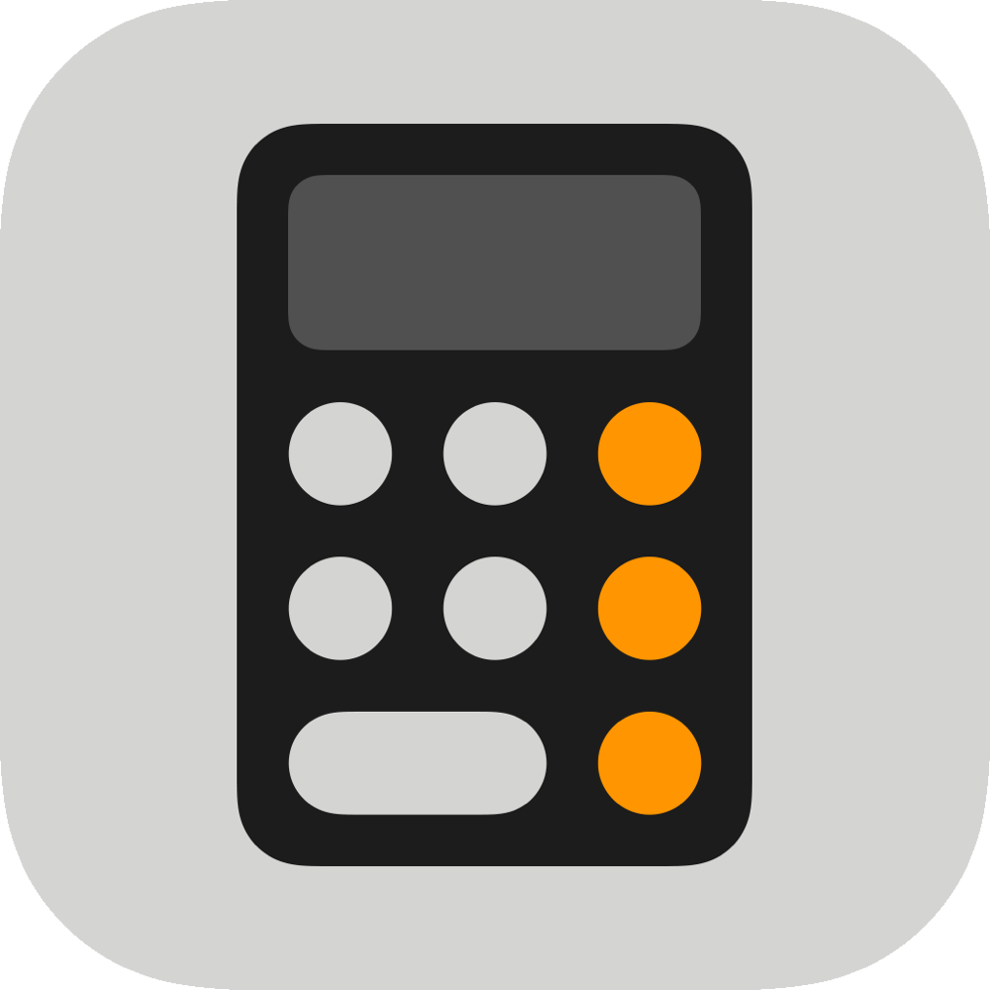
Basic arithmetic operations
Add
Substract
Negate [A is substracted from 0]
Increment [1 is added to A]
Decrement [1 is substracted from A]

Slide 14
Logic Unit
AND, OR, NOT
Simple numerical tests
  Checking if a number is negative
  Checking if a number is 0

Slide 15
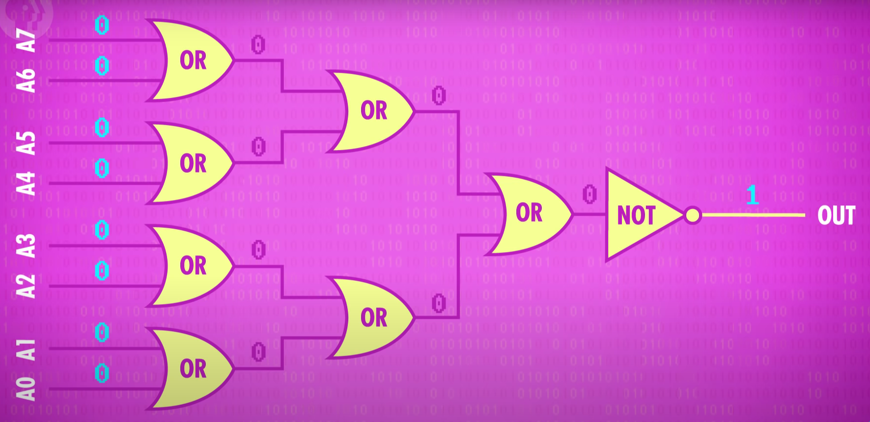
Is number equal 0?

Slide 16
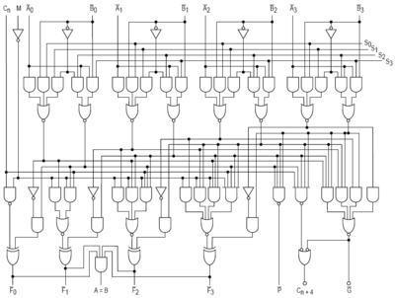
Intel 74181
4-bit operations – numbers from 0 to 15 or from -8 to 7
About 70 logic gates
No multiplication and division

Slide 17
Summary
ALU is responsible for every arithmetic and logic operation in the computer
ALU uses logic gates that implement basic logic operations
Computers add numbers in column, in order to add 8-bit numbers we need 1 half adder and 7 full-adders
Overflow happens when the sum is bigger than the biggest number we can store
ALU provides also more complex logic operations like checking if numer is equal 0 or negative

Slide 18

Questions
When was the first complete ALU on a single chip introduced? Which company did introduce it?
How can we detect overflow during integer addition?
Do you know how negative numbers are stored and computed in the computer? If you don’t, read about the “Two’s complement”.

